Slide 1
Identifying Seattle Real Estate Parcels for Redevelopment
Ross Frischmuth

Slide 2
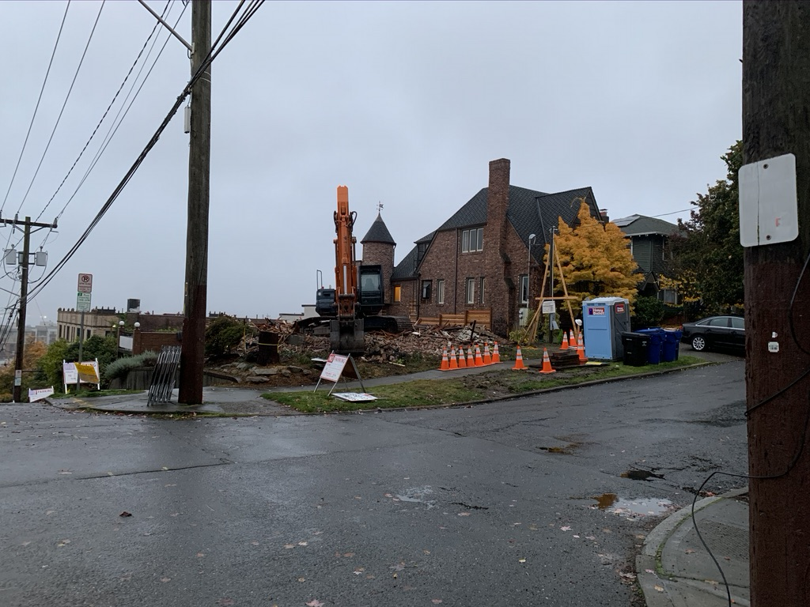
Problem Statement
Am I going to be living in a construction zone in the next few years?

Slide 3



Data Sources
King County Department of Assessments
Property value, zoning information, unit information
City of Seattle
Land use permits
King County GIS Center
Parcel Information
Notes:
GIS – Information about the land
Assessments – Information about the buildings
Inspection – Applied and approved demo permits

Slide 4
Data Set
161,521 rows x 21,149 columns
Rows: Land Parcels
Columns: Parcel Characteristics
754 residential parcels slated for demo
No historical data – only current buildings
Notes:
Restricted to Residential in the City of Seattle

Slide 5
Model
K-Fold Splits
10 Folds
predict 10% of parcels at a time on 90% of training data
Repeat 10 times to get predictions on all parcels
Random Forest
Memory overload on local machine
Logistic Regression (first model did 70/30 train/test)
Score with area under curve of ROC (receiver operating characteristic) curve
AUC = .507 – Really bad
Predict demo probability for every parcel
10 models – 90% train, 10% test
Compile all tests

Slide 6
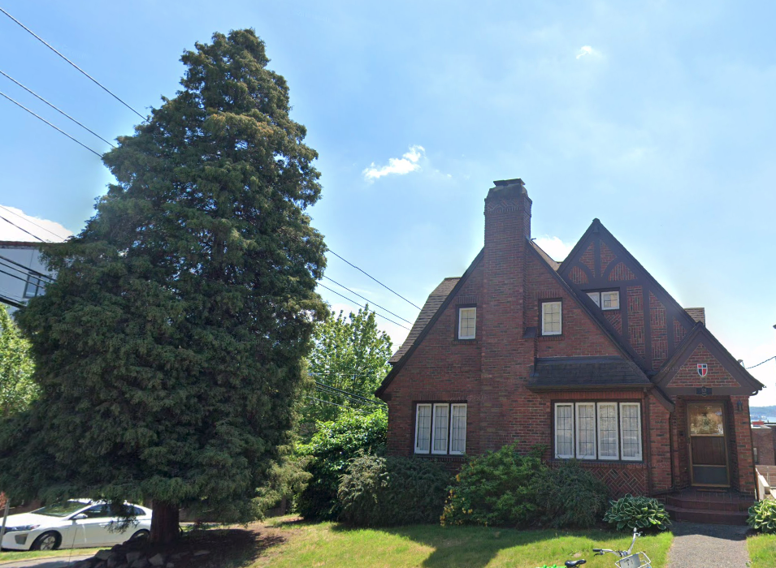
Results
Missed all 59 actual positives
Had 10 False Positives
One false positive was house that was just torn down across the street from my house.

Slide 7
Next Steps
K-Fold Splits
10 Folds
predict 10% of parcels at a time on 90% of training data
Repeat 10 times to get predictions on all parcels
Random Forest
Memory overload on local machine
Logistic Regression (first model did 70/30 train/test)
Score with area under curve of ROC (receiver operating characteristic) curve
AUC = .507 – Really bad
Update list of demo permits!
Incorporate historical property values into model
Build map application
Create address search functionality

Slide 8
Thank you
Ross Frischmuth

Slide 9
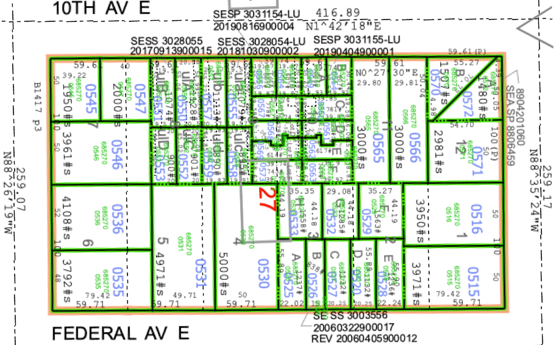
Deliverable
Display probability a specific parcel will redevelop
Assign value to property reflecting aggregate probability neighbors will redevelop

